Slide 1

Capstone Project-1
EDA on Hotel Booking Analysis
Team Project:
Kishor Kunal
Praveen Sikarwar
Punam Nagrale
Boncheruvu Teja
Rishi Chaturvedi

Slide 2
Problem Statement
For this project we will be analysing Hotel Booking data. This data set contains booking information for a city hotel and a resort hotel, and includes information such as when booking was made, length of stay, the number of adults, children or babies and number of available parking spaces.
Hotel industry is a very volatile industry and the bookings depends on above factors and many more.
The main objective behind this project is to explore and analyse data to discover important factor that govern the bookings and give insights to hotel management, which can perform various campaigns to boost the business and performance.

Slide 3

So we will divide our work flow into following 3 steps.

Slide 4
Data Collection and Understanding
After collecting data it’s important to understand your data. So we had hotel booking analysis data which had 119390 rows and 32 columns. So lets understand this 32 columns.
Data Description:-
hotel: Name of hotel ( City or Resort)
is_canceled: Whether the booking is canceled or not (0 for no canceled and 1 for canceled)
lead_time: time (in days) between booking transaction and actual arrival
arrival_date_year: Year of arrival
arrival_date_month: month of arrival
arrival_date_week_number: week number of arrival date.
arrival_date_day_of_month: Day of month of arrival date
stays_in_weekend_nights: No. of weekend nights spent in a hotel
Stays_in_week_nights: No. of weeknights spent in a hotel

Slide 5
adults: No. of adults in single booking record.
children: No. of children in single booking record.
babies: No. of babies in single booking record
meal: Type of meal chosen
country: Country of origin of customers (as mentioned by them)
market_segment : What segment via booking was made and for what purpose.
distribution_channel: Via which medium booking was made.
is_repeated_guest: Whether the customer has made any booking before(0 for No and 1 for Yes)
previous_cancellations: No. of previous canceled bookings.
previous_bookings_not_canceled: No. of previous non-canceled bookings.
reserved_room_type: Room type reserved by a customer.
assigned_room_type: Room type assigned to the customer.
booking_changes: No. of booking changes done by customers
deposit_type: Type of deposit at the time of making a booking (No deposit/ Refundable/ No refund)
agent: Id of agent for booking
company: Id of the company making a booking

Slide 6
days_in_waiting_list: No. of days on waiting list.
customer_type: Type of customer(Transient, Group, etc.)
adr: Average Daily rate
required_car_parking_spaces: No. of car parking asked in booking
total_of_special_requests: total no. of special request.
reservation_status: Whether a customer has checked out or canceled,or not showed
reservation_status_date: Date of making reservation status

Slide 7
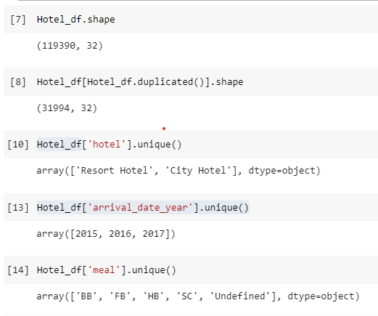
Data Cleaning & Manipulation:
1.We make a copy of Data copy as new DataFrame, So that the changes made in the copied data will not reflect in original data
2.And then remove duplicate out of this
After collection of Data, we got all the record about Hotel Type, Meal type ..etc.

Slide 8
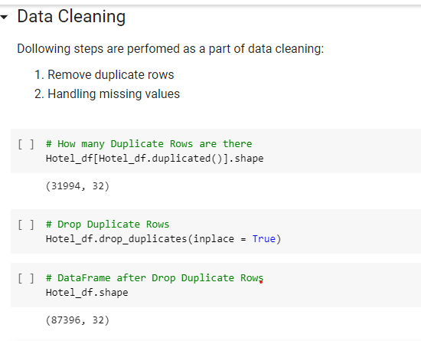
Data cleaning
Data cleaning helps to remove the redundant and useless data from the data set.

Slide 9
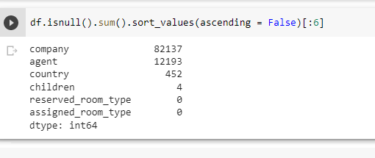
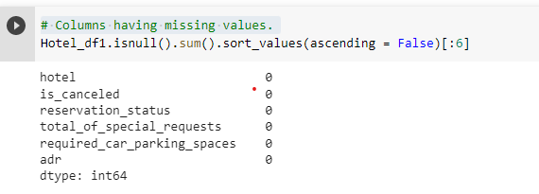
Find out Null Values in Data
After creating a copy, we performed data cleaning by deleting the duplicate and null values from the copy data set.

Slide 10
Exploratory Data Analysis (EDA) :
EDA will be divided into following 2 analysis.
1.Univariate analysis:->Univariate analysis explores each variable in a data set, separately. Like which hotel is mostly preferred by visitors.
2.Bivariate analysis:->It involves the analysis of two variables. Like Which type of room generating more ADR(average daily rate).
3.Multivariate analysis:->It involves the analysis of two or variables.

Slide 11
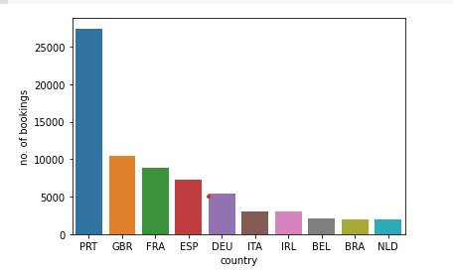
Country with more no. of guests
Conclusions:
Maximum number of guests were from Portugal. i.e. more than 25000 guests.
After Portugal, GBR(Great Brittan),France and Spain are the countries from where most of the guests came.

Slide 12
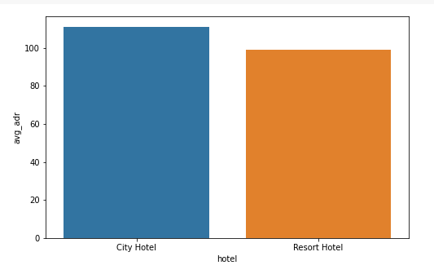
High Revenue hotel type
Conclusion:
City hotel has the highest ADR. That means city hotels are generating more revenues than the resort hotels. More the ADR more is the revenue.

Slide 13
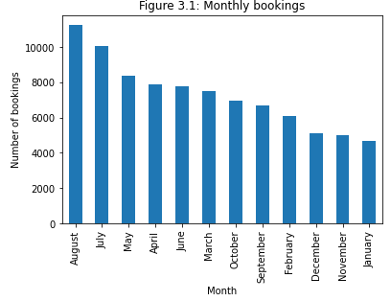
Month wise bookings of each hotel & busiest month
Conclusion:
The month wise booking are as below:
August 11257
July 10057
May 8355
April 7908
June 7765
March 7513
October 6934
September 6690
February 6098
December 5131
November 4995
January 4693
The Busiest Month is August, which have highest Bookings.

Slide 14
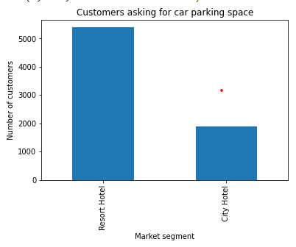
Customers asking for car parking space
Conclusion:
More customers from resort hotels are asking for carparking space.

Slide 15
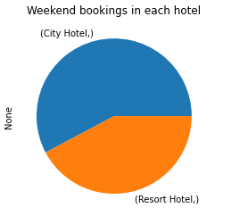
Hotel with maximum booking in weekend
Conclusion:
City hotels have more bookings in weekend nights.

Slide 16
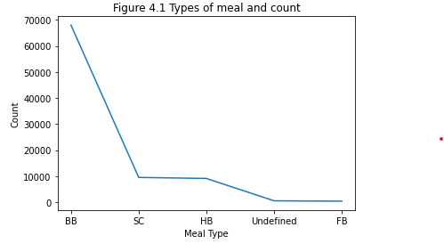
Most preferred meal type
Conclusion:
BB( Bed & Breakfast) is the most preferred type of meal by the guests.
Full Board i.e. FB is least preferred.
HB (Half Board) and SC(Self Catering) are equally preferred almost.

Slide 17
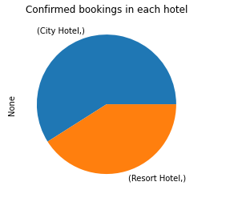
Total bookings in each hotel type
Conclusion:
City Hotels have more number of confirmed and are receiving more number of guests than Resort Hotels.

Slide 18
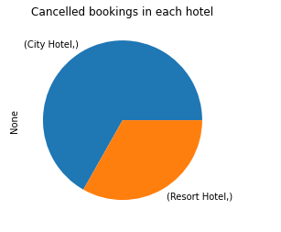
Comparing cancellations in each hotel type
Conclusion:
More customers are cancelling their bookings in the city hotels as compared to resort hotels.

Slide 19
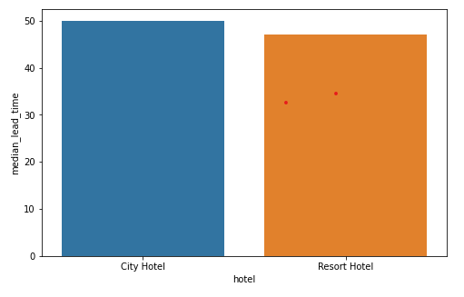
Hotel with higher lead time
Lead time:->The time gap between the date of booking and date of arrival.
Conclusion:
City Hotels have higher lead time than resort hotels.

Slide 20
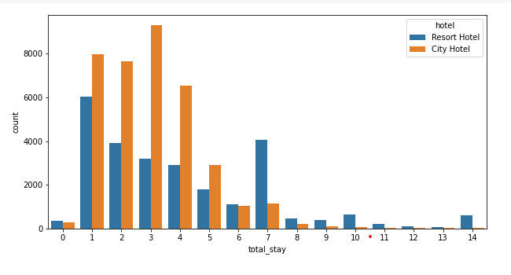
How many days people generally preferred stay in each hotel
Conclusion:
Preferred stay length is less than ‘7’ days. In both Hotel

Slide 21
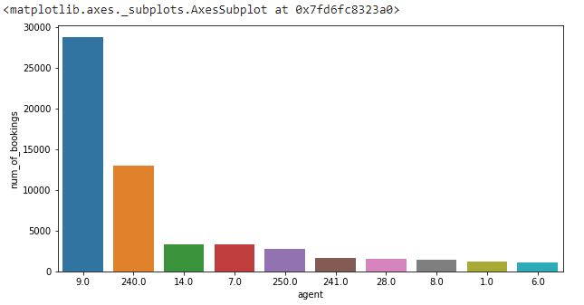
Agent wise bookings
Conclusion:
Agent with ID‘9.0’ is making more bookings.

Slide 22
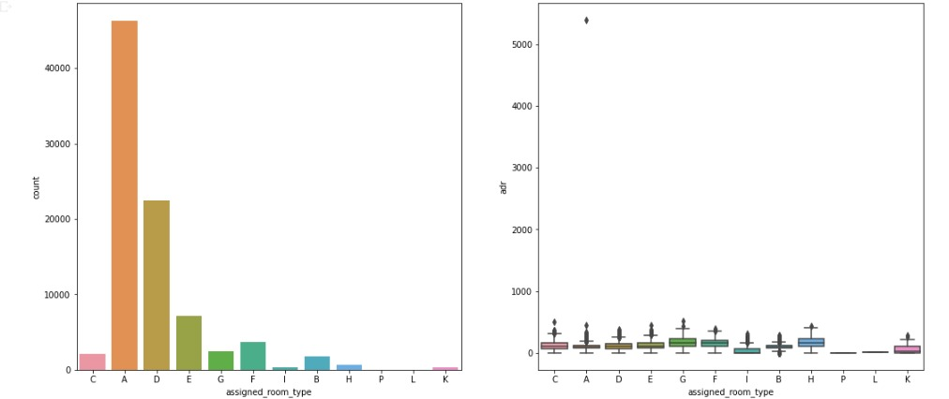
Most Preferred room type
More revenue generating room type
Conclusion:
Most preferred room type is ‘A’
Conclusion:
Most revenue generating room type is ‘G’

Slide 23
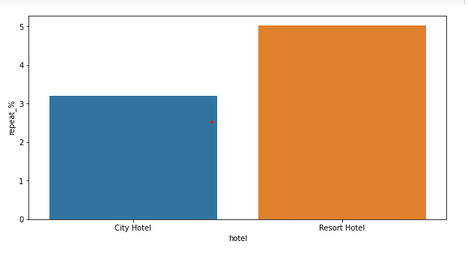
Hotel having more repeated customer
Conclusion:
Resort hotels have more repeated customers.

Slide 24
Conclusion:
1.We observe that the City Hotel is mostly preferred by the visitors i.e. about 61.1% in comparison to Resort Hotel(38.9%).Thus City Hotel has maximum booking.
2.The most prefer room type is A
3.We observe that the Agent having ID 9.0 made the most booking
4.we clearly se that Meal Type BB is most preferred
5.August is the Busiest month and July and August months had the most Bookings. Summer vacation can be the reason for the bookings.
6.TA/TO' is mostly(79.1%) used for booking hotels.
7.The City Hotel faces maximum hotel cancelation
8.Resort Hotel has slightly more repeated guests than the City Hotels. It is almost similar for both hotels.
9.Its is clear that there is no much(2.5%) effect on cancellation of the bookings even if the guests are not assigned with rooms which they reserved during booking

Slide 25
Thank You!

